Slide 1
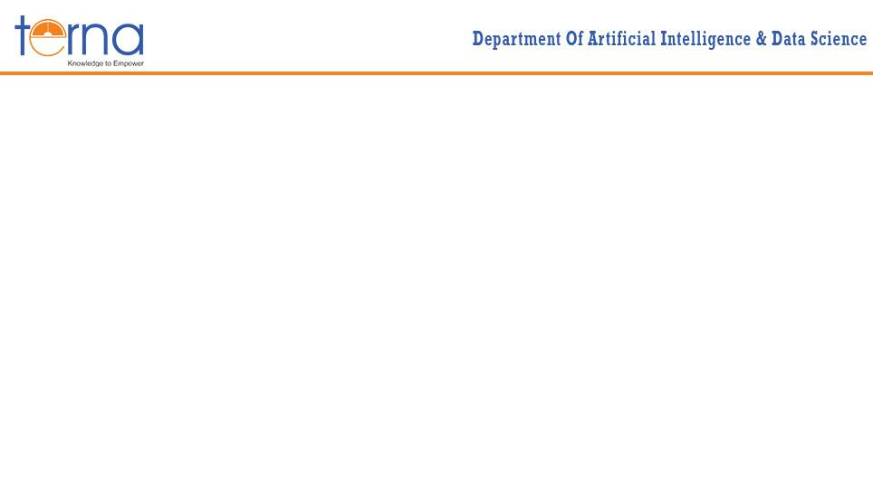
A Presentation on “SENTIMENT ANALYSIS”
Presented By
Bhanuja Sharma ID: TU8F2223016
Vaishnavi Mohite ID: TU8F2223018
Niharika Seth ID: TU8F2223007 Under the Guidance of Prof. Snehal Mane

Slide 2
INTRODUCTION
Sentiment Analysis is the process of identifying and categorizing opinions expressed in text to determine whether the attitude is positive, negative or neutral.
The project focuses on building a web-based sentiment analysis application using the Flask framework as the backend.
It leverages Hugging Face Transformers, which provide state-of-the-art pre-trained models for Natural Language Processing (NLP).
Specifically, the application uses BERTweet, a transformer model trained on 850 million English tweets, making it highly effective for analyzing social media text.
The system classifies user input text into three sentiment categories:
1. Positive
2. Negative
3. Neutral
The application exposes a REST API endpoint that accepts text as input and returns a structured JSON response containing the sentiment label and confidence score.
This makes it easy to integrate the model into front-end interfaces (e.g., websites, dashboards) for real-time sentiment analysis.

Slide 3
PROBLEM STATEMENT
Traditional Tools rely on simple lexicon-based methods, which struggle with complex or ambiguous sentences.
They often fail to correctly identify neutral sentiments, misclassifying them as positive or negative.
This leads to reduced accuracy and makes them less reliable for social media data where neutral opinions are very common.
A system is required that goes beyond two-class classification and supports three classes: positive, negative and neutral.
The API should leverage pre-trained models like BERTweet, which are trained on massive amounts of Twitter data and better handle slang, emojis and informal language.
The solution is to deploy REST API, making it accessible for integration with web applications and enabling real-time inference for user-facing platforms.

Slide 4
METHODOLOGY
1. Input Collection
The user enters text in the web interface (index.html) or sends via POST request.
Text is validated for empty input.
2. Preprocessing
Minimal preprocessing: stripping extra spaces.
Advanced NLP preprocessing (tokenization, embeddings) is handled internally by the BERTweet model.
3. Sentiment Analysis
Use Hugging Face Transformers pipeline to perform sentiment classification.
Model used: bertweet (3-class: POS, NEG, NEU).
Model outputs label and confidence score.
4. Mapping & Classification
Labels mapped to human-readable format:
POS → Positive
NEG → Negative
NEU → Neutral
Confidence score indicates model certainty for each prediction.

Slide 5
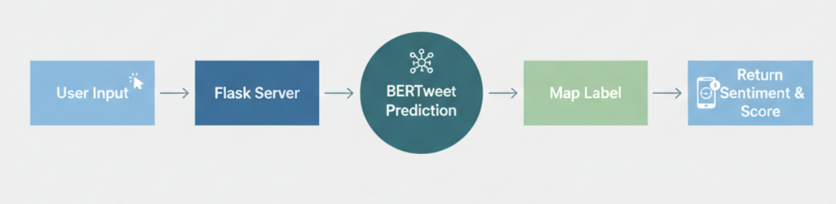
FLOWCHART

Slide 6
APPLICATIONS
1. Customer Feedback & Reviews
Analyze product or service reviews automatically.
Classify feedback as positive, negative, or neutral.
Identify trends in customer satisfaction for business improvement.
2. Social Media Monitoring
Analyze tweets, Facebook posts, or Instagram comments to track public sentiment.
Detect trending opinions about brands, events, or products.
Spot potential PR crises early.
3. Chatbots & Virtual Assistants
Enhance chatbots by understanding user emotions.
Respond differently to positive, negative, or neutral messages.
4. Market Research
Analyze sentiment from surveys, forums or online discussions.
Understand consumer preferences and adjust marketing strategies.

Slide 7
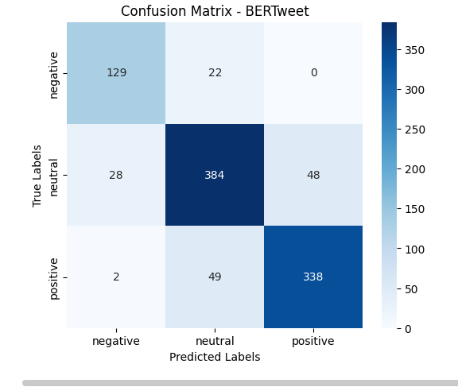
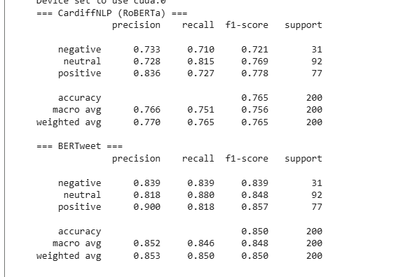
RESULT

